Slide 1
Data Case Study
Presented by Faith Were.

Slide 2
Introduction
The key focus areas of this case study included:
Payment behaviour analysis – Assessing how timely payments (or delays) correlate with various customer satisfaction metrics (NPS, CSAT, CES) and loyalty indicators.
Customer segmentation – Identifying patterns in behaviour (such as, payment frequency, loan amount, deposit trends) across different customer groups to target interventions.
Satisfaction trends – Analyzing the relationship between specific customer actions (i.e. payment fulfillment) and overall satisfaction scores, identifying pain points.
Churn prediction – Using dissatisfaction indicators to predict and pre-empt customer churn, particularly among users with late payments.
Revenue impact – Investigating how customer payment behaviour affects overall revenue streams and profitability, focusing on loan repayment trends.

Slide 3
Data Quality
To assess the consistency and reliability of the dataset with limited information, here’s how I would approach it:
1. Initial Data Exploration
Basic Statistics check - I would run the summary statistics (mean, median, mode, standard deviation) on numerical variables to identify any unexpected or outlier values.
Data type and format consistency – Verify that the data types are consistent (dates stored as dates, numbers stored as numerical values) and check for formatting issues.
Missing Data – Examine the dataset for missing values/NaNs and assess the extent of missing values. This could indicate data entry issues or system failures.
2. Duplicate data detection
Identify Duplicates - Search for duplicate rows, especially where each row should be unique (such as ‘loanuuid’ column). This helps ensure the data isn’t overrepresented or repeated.

Slide 4
Check unique identifiers - Verify the uniqueness of primary keys (i.e. the ‘loanuuid’ column) to prevent overlap.
3. Outlier Detection
Statistical Outliers - Use statistical techniques to identify outliers in numerical data that may indicate errors or anomalies.
Domain-Specific Outliers - Cross-check data against known realistic ranges to ensure values are reasonable.

Slide 5
After reviewing the datasets, these are the specific quality issues that I uncovered:
Missing Data
Month Paid Off Date - Only 32 out of 321 records are present, indicating a significant amount of missing data. This could affect analysis related to loan completion and repayment trends.
Due and Totpaid Columns (i.e. Due Eomth01, Totpaid Eomth01, etc.) - Varying counts across these columns suggest incomplete data for specific months. For example, Totpaid Eomth02 has 138 records, while Due Eomth01 has only 231. Missing payment data could distort calculations of financial obligations and actual payments.
NPS Score - There are only 79 records for the NPS score, meaning this data is not available for the majority of the dataset.
Old Csat X & Old Csat Y - These columns are entirely missing, with 0 records, indicating complete data absence for old customer satisfaction scores.
2. Inconsistent Data
Payment Columns (Due & Totpaid) - There are inconsistencies in the number of records across the various payment columns.

Slide 6
For example, the number of entries for Totpaid Eomth09 differs from Due Eomth09, indicating potential inconsistencies in capturing payments due and payments made.
NPS Scores - Incomplete NPS score data suggests inconsistent collection or recording, which may skew customer satisfaction analysis.
3. Outliers and anomalous values
Loan Price & Deposit - There are extreme values in these columns, such as loan prices as high as $204,699 and deposits of $33,999. These could be legitimate but may also be outliers that need further investigation.
Negative/unusual values - In some datasets, negative or unusually low values (such as -1 in the first dataset) were observed, though none are explicitly mentioned here. These values should be checked for correctness.
Weekly Rate - The wide range of weekly rates (from $560 to $3,350) could suggest either legitimate variability in loan terms or outliers that need to be verified.
4. Duplicated Data
The summary statistics don't explicitly mention duplication, but duplicates should be checked, particularly in columns like loanuuid, which serve as unique identifiers. Duplicate rows could distort results.

Slide 7
Basic Analysis
To address user dissatisfaction with information access, prioritizing the right metrics is essential. Here’s how I would approach this:
NPS Score (Net Promoter Score) - It is a direct measure of customer satisfaction and loyalty, reflecting users’ likelihood to recommend the service to others. I would break down NPS scores by different user segments to identify groups with the lowest satisfaction levels. This will help with targeting specific areas where dissatisfaction is highest.
Old Csat X & Old Csat Y (Customer Satisfaction Scores) - These metrics, though missing, are typically important in understanding past satisfaction trends. If data is recoverable or replaced with a current metric, they can give us insights into how satisfaction has evolved over time. I would compare old and new customer satisfaction trends to spot shifts in user satisfaction and focus on periods where declines are noticeable.
Monthly Payment Metrics (Due and Totpaid Columns) - Payment-related issues can directly affect user satisfaction, especially if users face challenges accessing information about their payment schedules or statuses. I would look for discrepancies between Due and Totpaid values to identify delays, missed payments, or potential confusion among users.

Slide 8
4. Loan Price and Deposit - High loan prices and deposit amounts may contribute to dissatisfaction, especially if users feel they are not receiving enough information about their financial obligations. I would segment the data by loan size and deposit amount to identify patterns where dissatisfaction is more prevalent.
5. Weekly Rate - If the weekly rate varies significantly and users are unclear on why their rates differ, this could lead to dissatisfaction. I would investigate the correlation between weekly rates and user feedback.
6. Temporal Metrics (Month Sale Date, Month Paid Off Date) - understanding when loans were issued and paid off can provide insights into how long users interact with the service and whether delays or extended timelines contribute to dissatisfaction. I would compare timelines for loans that were paid off versus those still outstanding. Identify if certain periods correlate with increased user complaints or lower satisfaction scores.
7. Loan Status and Repayment Journey - Metrics that capture the user's loan repayment journey, such as repayment frequency, amounts due versus paid, and overall loan status, can significantly impact satisfaction. Lack of clear information on these can be frustrating. I would go about examining the journey metrics for users who expressed dissatisfaction.

Slide 9
Engagement Metrics - While this is not explicitly mentioned in the dataset, engagement metrics such as how often users access their account or seek information can highlight frustration points in information access. If this information was available, I would track user behavior related to accessing information (such as frequency of logins, queries made). Also cross-reference with NPS and Csat scores to identify if frequent access attempts correlate with dissatisfaction.

Slide 10
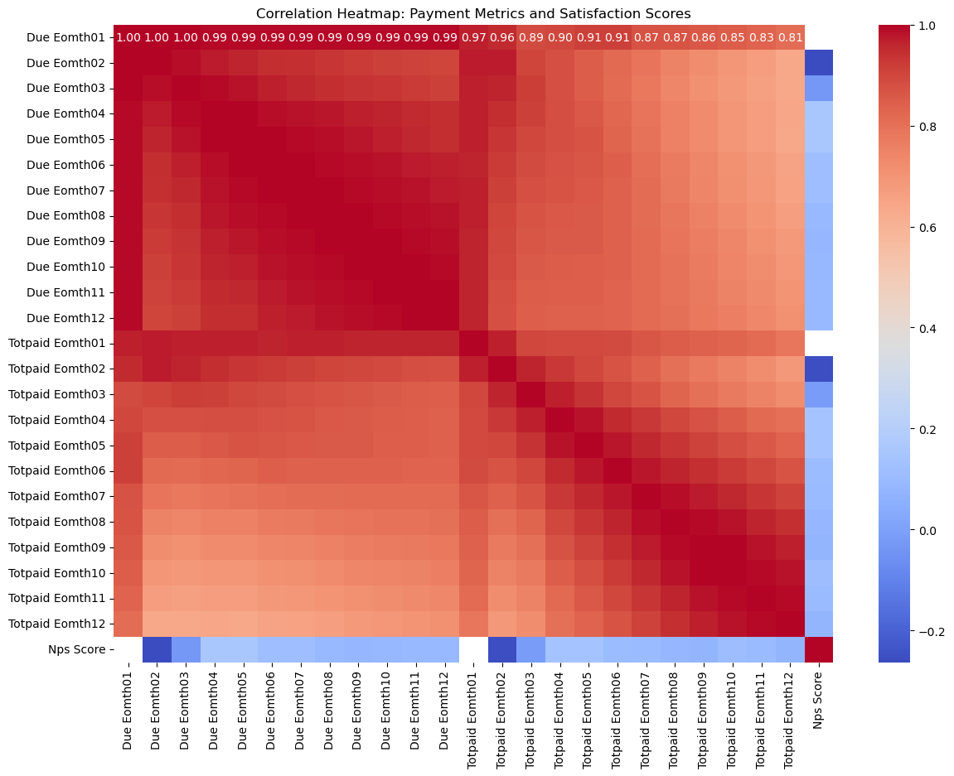
Key Insights extracted from user payment behavior
Correlation between all the columns

Slide 11
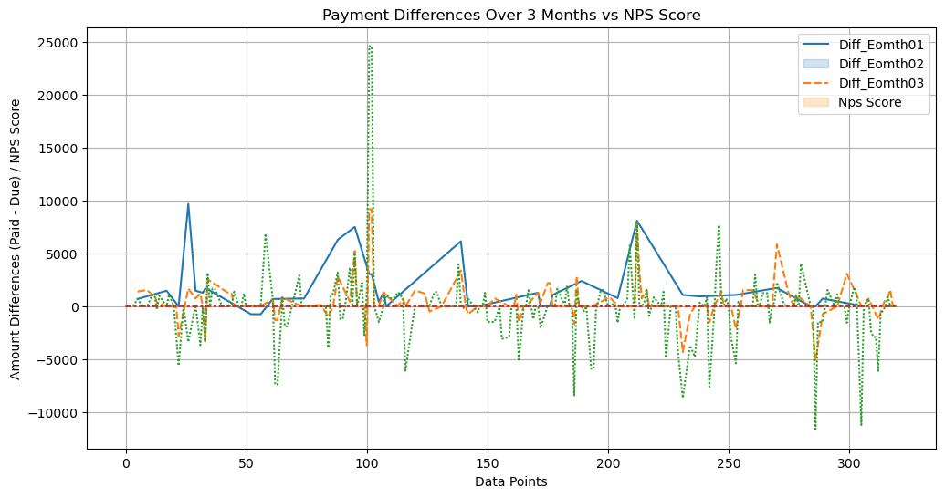
1. Payment Differences Over 3 Months vs NPS Score
Users who pay early or on time have a higher NPS score compared to those who make late payments. This suggests that payment timeliness may positively impact customer satisfaction and loyalty.

Slide 12
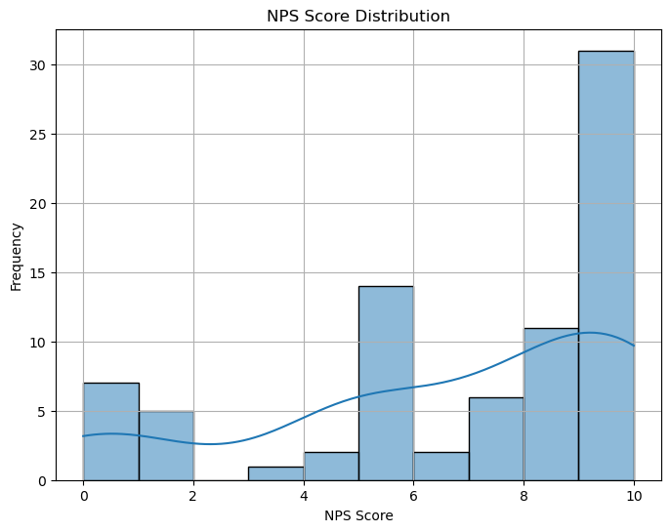
2. NPS Score Distribution
The dissatisfaction rate is not widespread or concentrated in specific user groups. This implies that a larger percentage of customers are satisfied with the services at MoPhones.

Slide 13
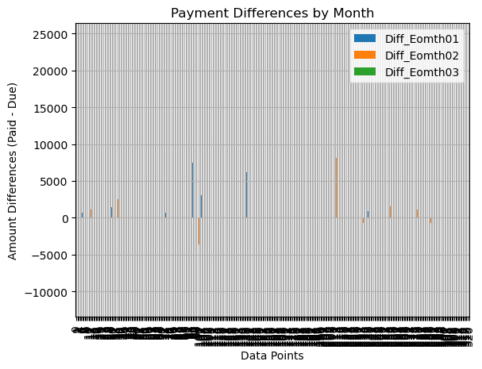
3. Payment Differences by Month
The chart provides insights into how payment patterns fluctuate month-to-month, potentially revealing trends such as seasonal effects, payment cycles, or emerging issues with customer payments that could impact satisfaction.

Slide 14
Hypothesis Validation
To formulate a hypothesis about the impact of payment timeliness on user satisfaction, the hypothesis could be:
Users who consistently pay on time are more likely to report higher satisfaction (as measured by NPS, CES, and CSAT scores) compared to users who pay late.
To validate this hypothesis, the following preliminary data would be needed:
Payment Timeliness Data
Date of payment relative to the due date (such as days early, on time, or late).
Whether payments were consistently on time across multiple periods (i.e. monthly, weekly).
2. User Satisfaction Scores
NPS (Net Promoter Score) - Measures how likely users are to recommend the service.
CES (Customer Effort Score) - Measures how easy it is for users to access services.
CSAT (Customer Satisfaction Score) - Direct satisfaction rating from users.
Consistency of Payment Behaviour
The proportion of on-time versus late payments over time per user.
Frequency of missed or delayed payments.

Slide 15
User Segmentation Data
Segmentation of users based on payment behaviour.
Demographic information to understand if certain user groups are more prone to late payments.
Historical Payment Patterns
Trends in payment behaviour (i.e. Is payment timeliness improving or deteriorating over time).
Relationship between changes in payment timeliness and corresponding changes in satisfaction scores.

Slide 16
To validate the hypothesis that “users who consistently pay on time are more likely to report higher satisfaction compared to users who pay late,” external and public sources can provide valuable insights and context, these are the ways I would go about it:
Conduct industry benchmarks – I would use industry reports on NPS, CSAT, and CES to compare satisfaction metrics with external standards.
Carry out consumer behaviour studies – I would leverage research on the correlation between timely payments and customer satisfaction from behavioural economics.
Public Databases – I would access data from regulatory bodies that track customer complaints related to payment timeliness and satisfaction.
Competitor Analysis – I would analyze customer reviews and satisfaction ratings of competitors to identify similar trends in payment behaviour and dissatisfaction.
Regulatory Reports – I would utilize government and regulatory reports that explore the impact of payment behaviours on customer experiences across industries.

Slide 17
THANK YOU

